Slide 1

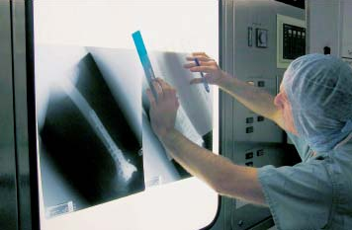
Digital Preoperative Planning for Long-Bone Fractures
Esmitt Ramírez
Ernesto Coto
esmitt.ramirez@ciens.ucv.ve
ernesto.coto@ciens.ucv.ve
Universidad Central de Venezuela
X CIMENICS – Mérida, Venezuela 2010
Notes:
Tuesday December 23th. 04:40 pm – 05:00 pm
Good Afternoon. I am Esmitt Ramírez from the Central University of Venezuela. My talk is about digital preoperative planning for long-bone fractures … This is joint research with the Professor Ernesto Coto from the Central University of Venezuela and myself.

Slide 2
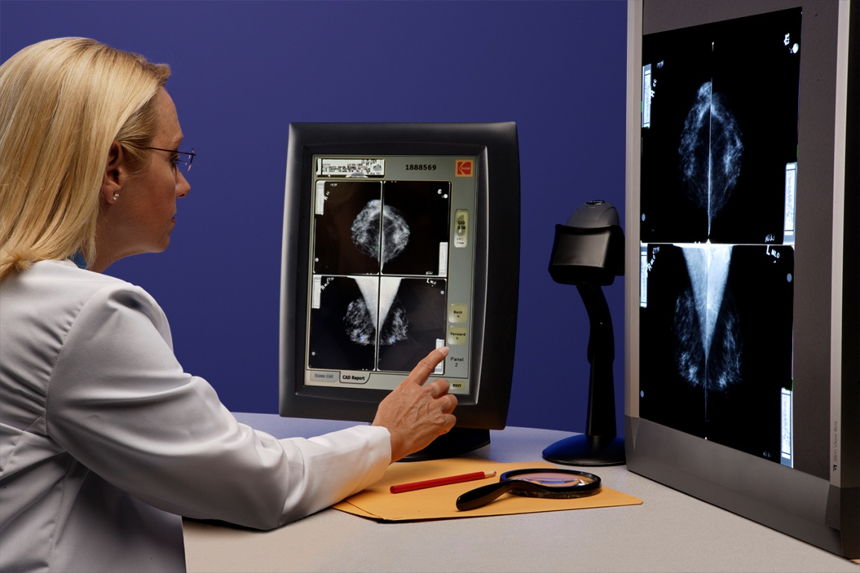
Introduction
Nowadays, digital images are a fundamental base to medical diagnosis
CAD (Computer Aided Diagnosis) systems provide support in preoperative surgery planning
CAOS – Computer Aided Orthopedic Surgery
2/18
Notes:
<some intro text>
Nowadays, digital images are a fundamental base to medical diagnosis. The continuous research and development in this topic allows build a variety of computer systems based on these digital images to be use in medical support tools. In particular, CAD systems, that mean Computer Aided Diagnosis, are useful tool to provide support in preoperative surgery planning.
A kind of CAD system is called CAOS or Computer Aided Orthopedic Surgery, that works in Radiology area in some medical healthcare centers. With CAOS systems is possible make a plan to an operation before the patient enter to the Radiology surgery room.

Slide 3
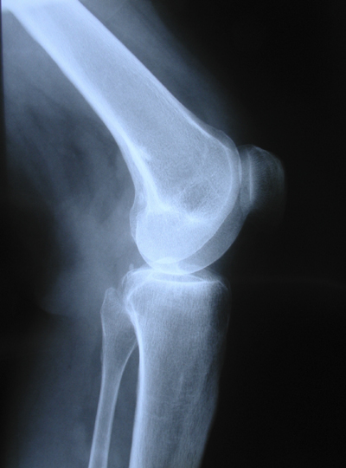
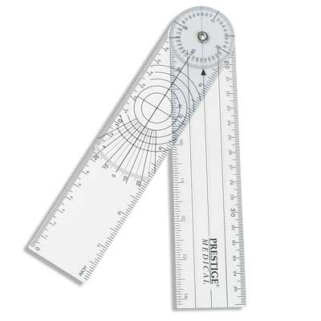
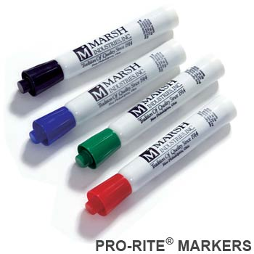
Preoperative Planning
It helps estimating the final result of the surgery
It consists of a trace of the fracture, the steps to follow during surgery and the implant to be used
Often the tracing is done manually in paper
+
+
3/18
Notes:
The preoperative planning is the process to build a plan with the aim to have control in each step during the operation. The preoperative plan help to estimates the final result of the surgery. Mainly, its consists of a trace of the fracture, the steps to follow during surgery and the implant to be used. The trace of the fracture consists in select the border of bone fragments using markers, the patient X-ray and a rule call goniometer (how it observed in the slide). The idea is place the X-ray in a viewbox, present in any Radiology department, draw the border of bone fragments and puzzling (pronunciation) fragments and place them in their correct position for fracture reduction, and finally add information about the patient or the procedure. For a fracture reduction, should be necessary use implants such as plates, nails, etc. to place in the patient.

Slide 4
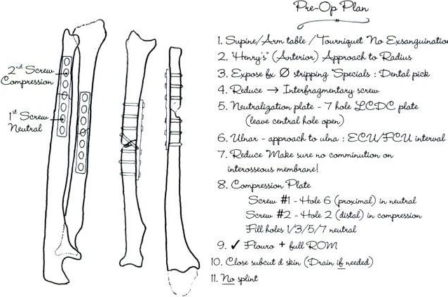
Preoperative Planning
4/18
Notes:
We can see in this example, a basic preoperative plan where shows a puzzling process of bone fragments with instructions and comments wrote by the surgeon. This plan was done manually over a trace paper.

Slide 5
CAOS system
Manual procedure (pen-paper) consumes long time
Manual procedure is error-prone
Instead, CAOS systems are used in many healthcare centers
CAOS systems make digital planning possible
Then, our proposal is
Eliminate the pen-paper method
Build a low-cost CAOS solution
Special hardware must not be required
5/18
Notes:
So, the manual procedure, using markers and paper, consumes long time and this procedure is error-prone. For this reason, CAOS systems are used in many healthcare center at whole world. Then, with CAOS systems is possible make a digital planning.
Basically, our proposal is based on: Eliminate the pen-paper method building a low-cost CAOS solution to be used in long-bone fractures. Additionally, it’s important notice that our system don’t require any special hardware just it needs a conventional PC.

Slide 6
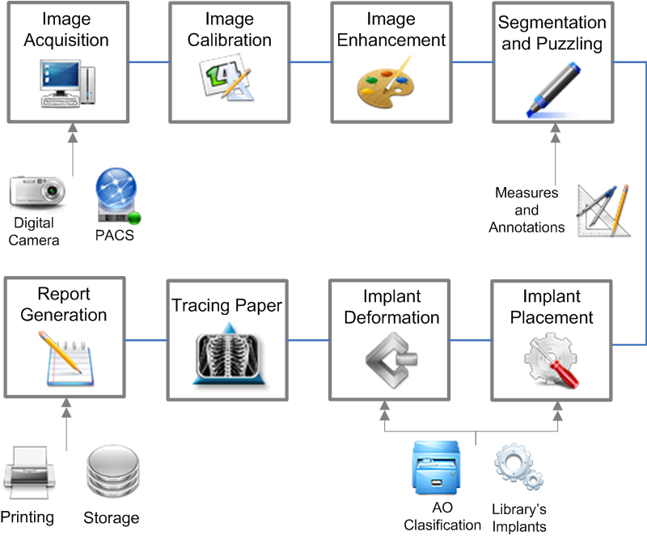
Proposed Scheme
6/18
Notes:
Well, our proposed consists in a scheme of eight stages: Image Adquisition, Image Calibration, Image Enhancement, Segmentation and Puzzling, Implant Placement, Implant Deformation, after Tracing Paper and finally Report Generation. At the end of all these steps, system generated a digital preoperative plan. Next, we explain each step of our scheme.

Slide 7
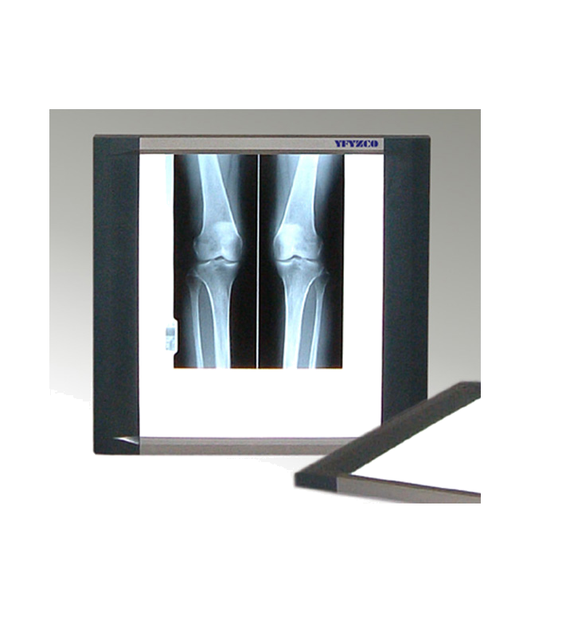
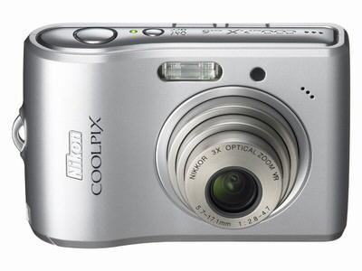
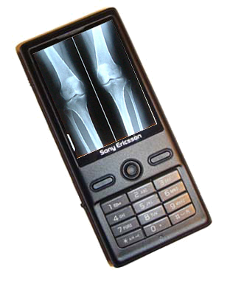
Image Acquisition
+
=
digital format
Prerequisites
Controlled environment (lighting, distance to shoot)
Resolution of at least 800x600 pixels (0.5 megapixels)
Focus in the area of interest (i.e. the fracture)
7/18
Notes:
In the Image Acquisition stage, an image will be load using a DICOM formal file or a picture taken using a conventional digital camera of the X-ray plate placed over a viewbox. This way is an easy solution because any electronic supplies that contains a camera is enough for this stage. Some prerequisites are required. First, the image would be taken in a controlled environment, I mean a good light conditions, an adequate distance to shoot by example the shooter must be in front of the viewbox. Another prerequisite is about the resolution of the digital camera: it requires at least 800x600 pixels of resolution. Finally, the shoot have to focus only over the fracture zone.

Slide 8
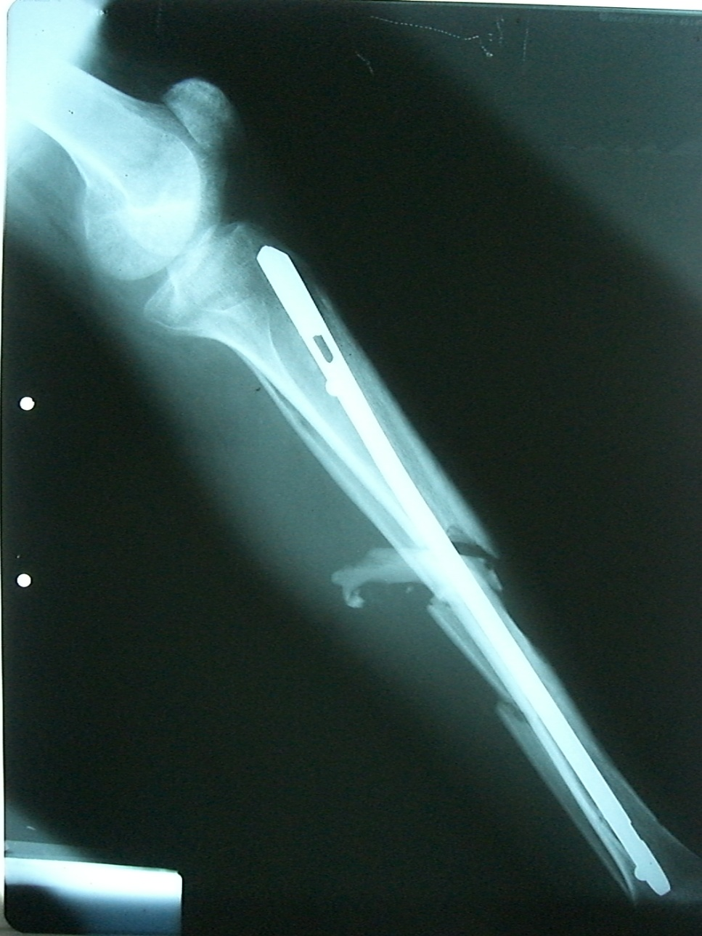
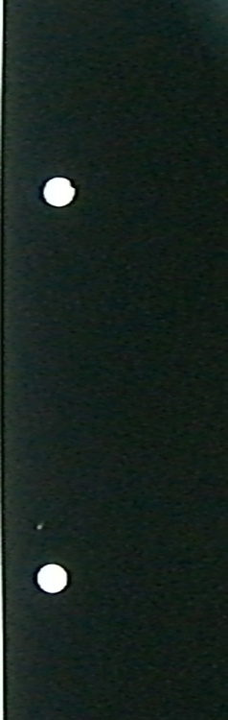
Image Calibration
Distance between holes is
configurable
Standard ISO 838 establishes this distance is 12±1 mm
8/18
Notes:
In the Image Calibration stage the aim is do the Matching between the X-Ray physical dimensions and the logical image dimensions. This calibration is required for measurements, calculating the implant dimensions, calculating width and height of a bone, etc.
In this stage, we used the gap left by a two-hole paper punch like our reference. In the picture we can see this distance. The standard ISO 838 establishes this distance in 12 +- 1 mm. For our system, this distance is configurable.

Slide 9
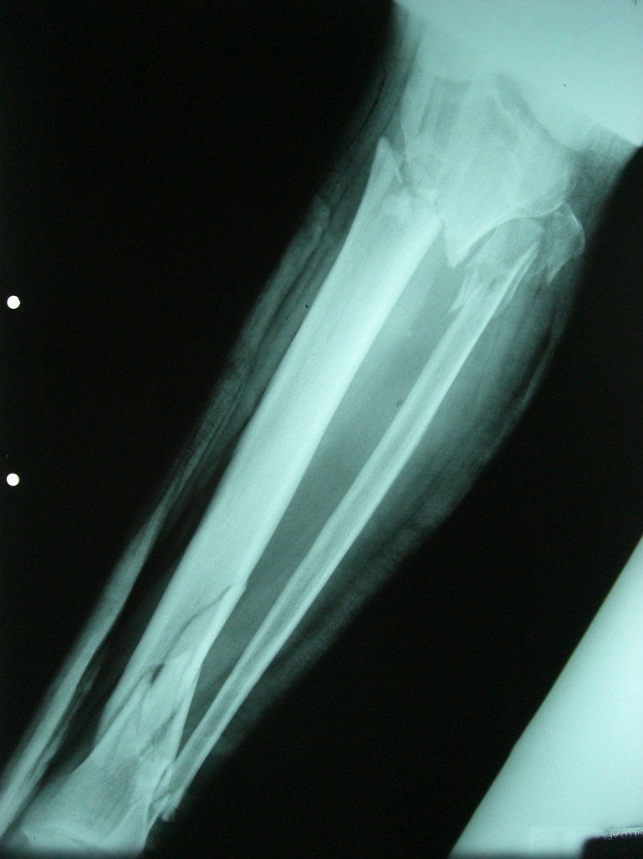
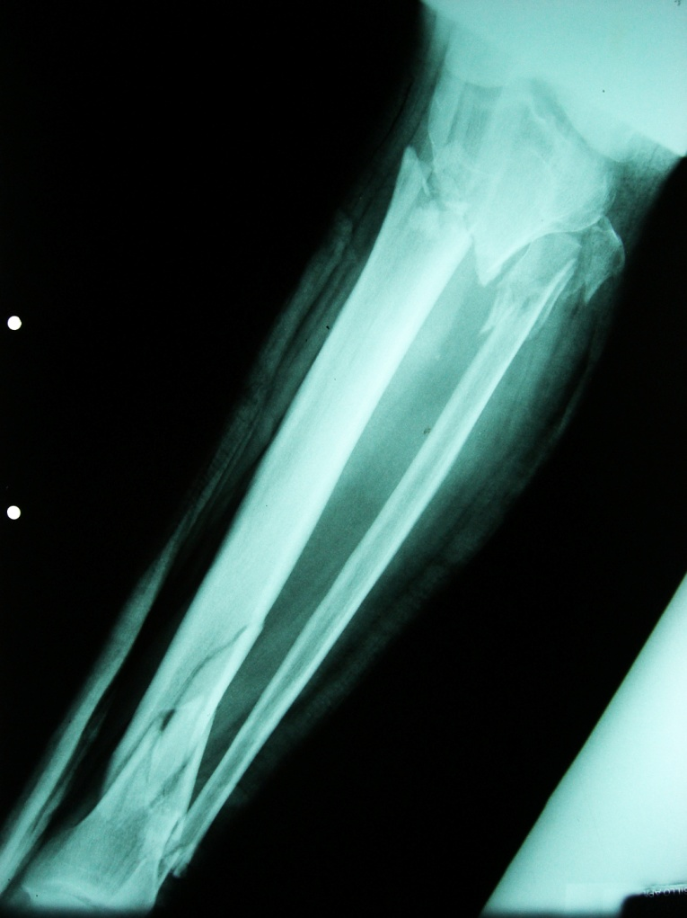
Image Enhancement
Necessary to obtain a better image contrast
Manual window/level adjustment
9/18
Notes:
In the image enhancement stage is just for change the contrast value of the image. For do that, a manual window/level adjustment is execute by the surgeon in the software.

Slide 10
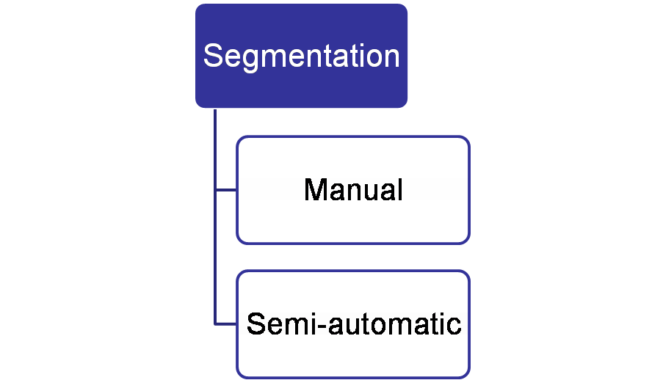
Segmentation and Puzzling
Segmentation: Extract from the image all bone segments separated by the fracture
Puzzling: Place these bone segments in their anatomically correct positions using translations or rotations
In manual mode, the surgeon has full control over the segmentation
In semi-automatic mode, a Canny border detection algorithm is used to find the border of each bone segment
10/18
Notes:
In the Segmentation and Puzzling stage, we can define a segmentation like a process to extract from image all bone segments separated by the fracture. This bones segments are generated by impact lesion for example. Next, we can define the puzzling like the process to place these bone segments in their anatomically correct positions using translations or rotations.
In our system, segmentation can be executed in two ways: manual, where the surgeon has full control over the segmentation and semi-automatic mode, where a simple Canny border detection algorithm was applied to find the border of each bone segment.

Slide 11
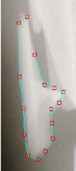
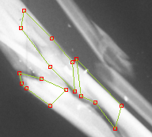
Segmentation and Puzzling
A fracture would produce many bone fragments
The measurement tool is very useful to calculate the length of the bone, the length of the implant, etc.
For a later reviewing, different annotations should be written
Not all segments fit exactly in their correct anatomical position, a very close approximation is enough for planning
11/18
Notes:
It’s important notice that a fracture would produce many bone fragments as shown in Figure. For a later reviewing, different annotations should be written. The surgeon, just need a very close approximation for the planning because not all segments fir exactly in their anatomical position.

Slide 12
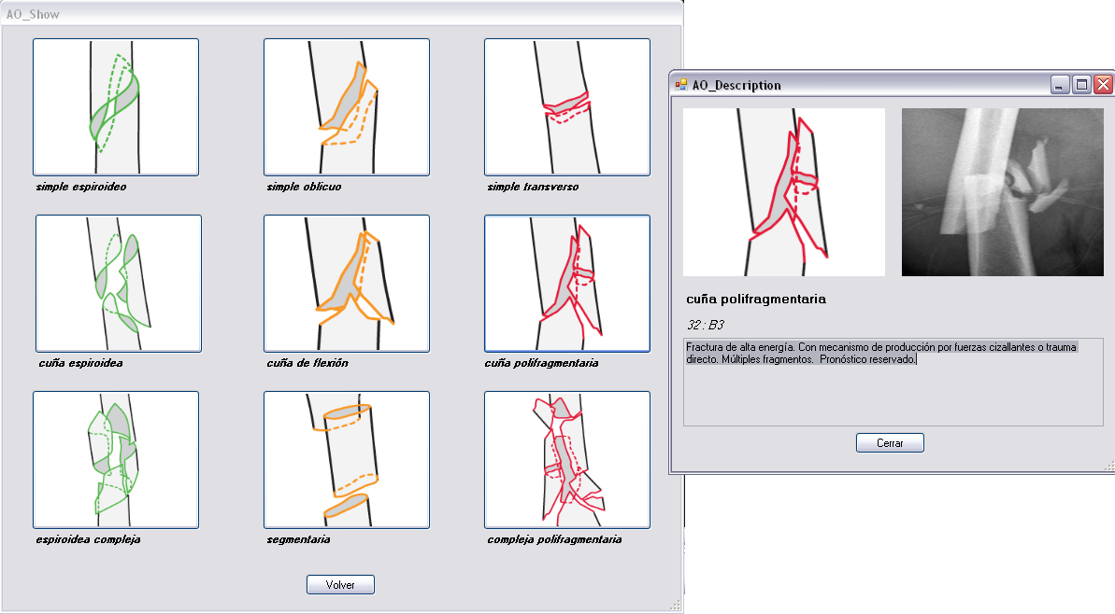
Implant Placement
When the puzzling process is completed, the surgeon decides whether to put an implant on the patient or not
A library of implants is provided, including: plates, screws and pins
MySql® is used to store information about implants
Each implant is
represented using a
STL file which stores
the 3D triangulated
surface of the implant
A complete library of
AO² fractures is also available
12/18
Notes:
Once we have the bone fragments, then the surgeon decides put an implant over the patient or not put it. The decision to put an implant is completely of the surgeon. Our system provides a library of implants, including plates, screws, pins, etc. made by different manufactures. For stores the information related with implants, a MySql database was used. For each implant, we use a 3D geometry representation. A STL file stores that representation. Additionally, our system offers a complete library of AO fractures classification. For each type of classification, we show a little description and a couple of images how it observed in the image.

Slide 13
Implant Deformation
In some cases, surgeons might need to bend an implant
The implant deformation process is useful to plan the bending operation over the implant during the surgery
At the surgery room, the surgeon applies a deformation over the implant using a specialized groove plier
Our system allows the digital deformation of the implant prior to the surgery
13/18
Notes:
In some cases, surgeons might need to bend, to deformed an implant. Then, in this stage, implant deformation, the surgeon can plan the bending that he will use in the surgery. At surgery room, the surgeon applies this deformation using a specialized groove plier. This deformation process is executed by our system using a simple bending algorithm.

Slide 14
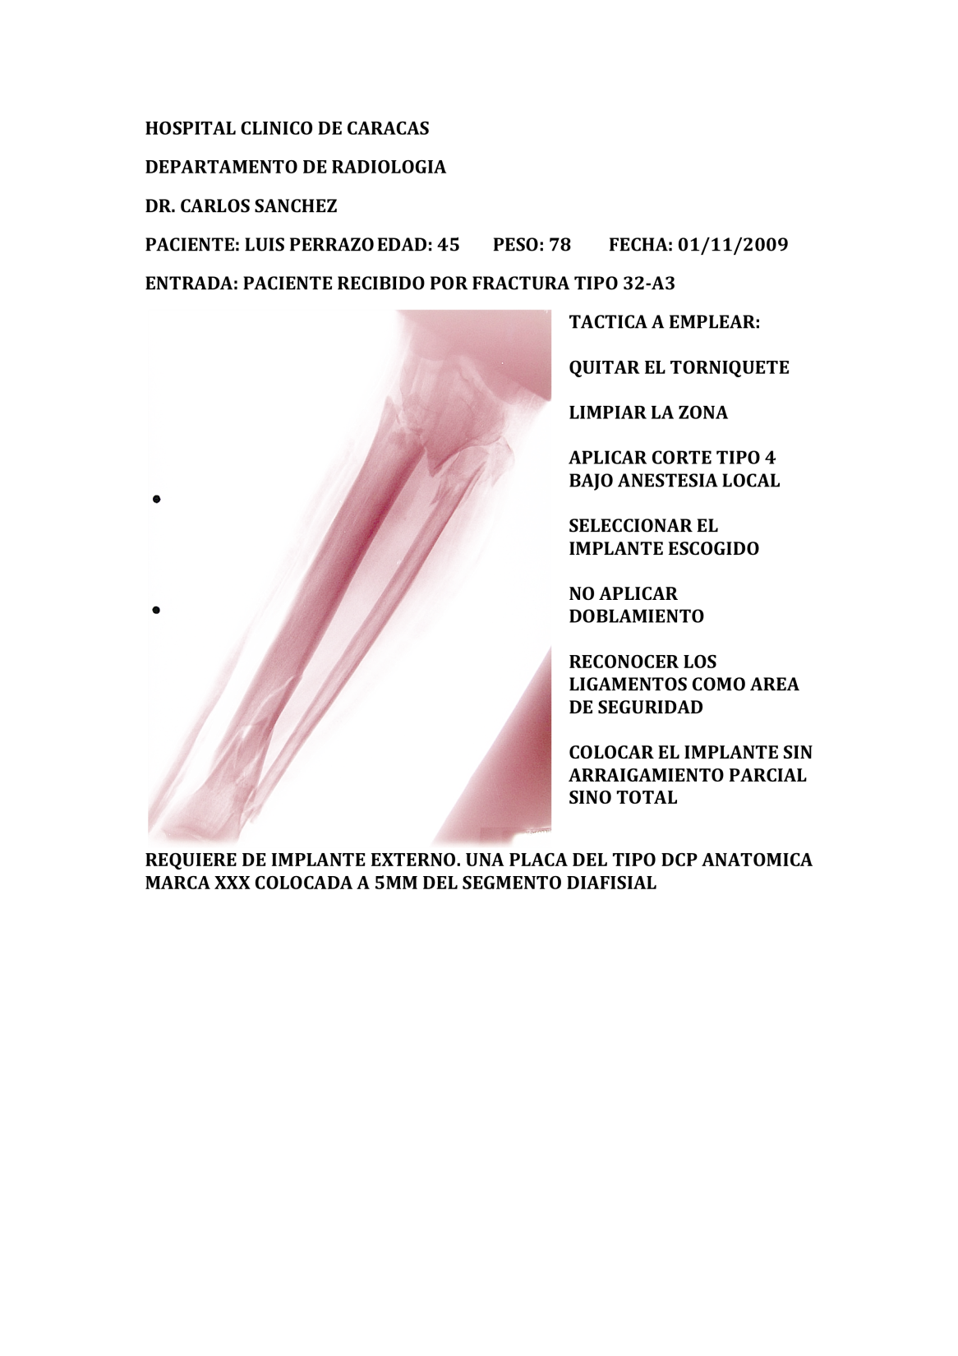
Tracing Paper and Report Generation
Finally, the system can print out the tracing paper and a report that includes: annotations, measurements, fragments of bones, etc.
At this point, the
preoperative planning
is complete!
14/18
Notes:
Finally, the two last stages: Tracing Paper and Report Generation. In this point, the system can print out the tracing paper and the report that includes annotation, measurements, fragments of bones, etc.

Slide 15
Results and Conclusions
We installed our system in a standard PC without specialized hardware at the Radiology Department of the HUC (University Hospital of Caracas) in Venezuela
Two experts were instructed on how to use the system in a short time
Without the system, the surgeons create a preoperative planning manually in 8 to 25 minutes approximately
With the system the planning time varied from 2 to 5 minutes
That represents a considerable reduction of the planning time and positive feedback about results of the system
15/18

Slide 16
Future works
Implementing a better border detection algorithm, e.g. algorithms based on active contours or deformable models
Extends our system to support others object of reference
Take advantages of current technology to speed up the annotation process, e.g. using speech recognition tools, medical tablet PC’s, etc.
16/18

Slide 17
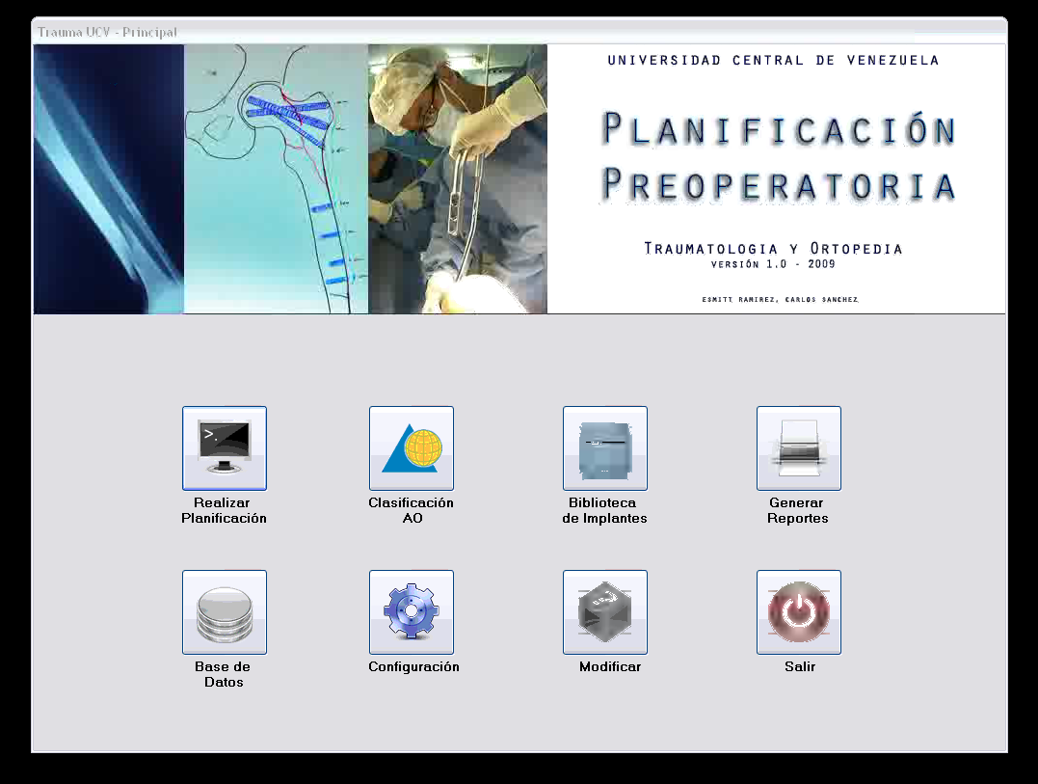
Demo Video
17/18
Notes:
Here we can see a short demo video.

Slide 18



Questions
http://ccg.ciens.ucv.ve
{esmitt.ramirez | ernesto.coto}@ciens.ucv.ve
18/18
Notes:
Any question?

